Slide 1
Bronchial and nasal epithelium: are they the same?
Marco Caminati

Slide 2
Conflicts of interest disclosures
Consultancy fees received from AstraZeneca​ and GSK​
Speaker fees received from AstraZeneca​, GSK and Sanofi​​
Educational programmes with GSK

Slide 3
The case of allergic rhinitis and asthma: epidemiology¹
Approximately 30% of patients with allergic rhinitis develop asthma during their lifetime¹
Globally, allergic rhinitis is a relevant risk factor for asthma onset (OR 3.4–4.1)¹
Up to 80% of patients with persistent asthma suffer from co-existing allergic rhinitis¹
OR, odds ratio
1. Tenero L, et al. J Asthma Allergy 2023;16:45–57
Notes:
Tenero L, Vaia R, Ferrante G, et al. Diagnosis and Management of Allergic Rhinitis in Asthmatic Children. J Asthma Allergy 2023 Jan 5;16:45–57

Slide 4
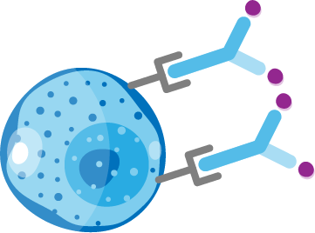


The case of allergic rhinitis and asthma: burden¹
Even in the absence of symptomatic asthma,
a relevant proportion of patients with allergic rhinitis present with AHR¹
Patients with allergic rhinitis without asthma show lower airways inflammation when compared with patients with both allergic rhinitis and asthma, as well as displaying some degree of airway remodelling¹
Nasal allergen provocation testing leads to significantly increased inflammatory biomarkers in bronchial mucosa¹
The coexistence of allergic rhinitis and asthma leads to a greater burden of disease (more asthma exacerbations)¹
Suboptimal allergic rhinitis control is associated with worse asthma control¹
Early phase of allergy
(minutes)
Late phase
(maximal at 6–9 hours)
Basophil
Mast cell
Eosinophil
IL-5
Cytotoxic
molecules
MBP, EPO
Recruitment of Th2 cells; eosinophil activation
Mast cell
degranulation
Epithelial/tissue
damage; AHR
Mast cells
More
eosinophil
progenitors
Activation of
neutrophils
Class switching of
plasma cells – IgE
Figure informed by Akkoc T, et al. Allergy Asthma Immunol Res. 2011;3(1):11–20; Davoine F, Lacy P. Front Immunol 2014;5:570; Galli SJ, et al. Nature 2008;454:445–454; McBrien CN, Menzies-Gow A. Front Med (Lausanne) 2017;4:93; Pawankar R, et al. Asia Pac Allergy 2011;1:157–167; Ramirez GA, et al. Biomed Res Int 2018;2018:9095275
AHR, airway hyperresponsiveness; EPO, eosinophil peroxidase; IgE, immunoglobulin E; IL, interleukin; MBP, major basic protein; Th, T helper
1. Tenero L, et al. J Asthma Allergy 2023;16:45–57
Notes:
Figure informed by Pawankar R, Mori S, Ozu C, et al. Overview on the pathomechanisms of allergic rhinitis. Asia Pac Allergy 2011 Oct;1(3):157–167 and Galli SJ, Tsai M, Piliponsky A. The development of allergic inflammation. Nature 2008 Jul 24;454(7203):445–454
Tenero L, Vaia R, Ferrante G, et al. Diagnosis and Management of Allergic Rhinitis in Asthmatic Children. J Asthma Allergy 2023 Jan 5;16:45–57

Slide 5


The case of CRSwNP prevalence in patients with severe asthma¹
Patients with severe asthma in Italy¹*
Parameter | Value
Age (years), mean ± SD | 54.1 ± 13.7
Sex, females (%) | 250 (57.2%)
Atopic, n (%) | 309 (70.7%)
Sensitised to perennial allergens, n (%) | 272 (62.2%)
Active smokers, n (%) | 12 (2.7%)
Past smokers, n (%) | 88 (20.1%)
BMI, mean kg/m² ± SD | 26.2 ± 5.0
BMI (kg/m²) classes, n (%)
<18.5 | 7 (1.6%)
18.5–24.9 | 190 (43.5%)
≥30 | 87 (19.9%)
Age of onset (years), mean ± SD | 32.4 ± 17.1
Late onset, n (%) | 167 (38.2%)
Exacerbations/year, mean ± SD | 3.75 ± 7.2
Exacerbations in the last 12 months
0 | 76 (17.4%)
1 | 49 (11.2%)
2 | 99 (22.7%)
>2 | 213 (48.7%)
Emergency department visits per year, mean ± SD | 0.49 ± 0.97
Hospitalisations per year, mean ± SD | 0.25 ± 0.07
Intubation or mechanical ventilation events per year, mean ± SD | 0.06 ± 0.39
Of patients with severe asthma from the SANI registry:¹
71.4%
≥2 exacerbations in the previous year¹
64.1%
prescribed OCS¹
38.2%
late-onset asthma¹
79.8%
>150 blood eosinophils/µL¹
42.6%
CRSwNP¹
*Based on a study of 437 patients with severe asthma from the SANI registry¹
BMI, body mass index; CRSwNP, chronic rhinosinusitis with nasal polyps; OCS, oral corticosteroid(s); SANI, Severe Asthma Network in Italy; SD, standard deviation
1. Heffler E, et al. J Allergy Clin Immunol Pract 2019;7:1462–1468
Notes:
Heffler E, Blasi F, Latorre M, et al. The Severe Asthma Network in Italy: findings and perspectives. J Allergy Clin Immunol Pract 2019 May–Jun;7(5):1462–1468

Slide 6
The case of CRSwNP burden in patients with severe asthma^{1,2}
Patients with severe asthma in Italy¹
Parameter | Value
Age (years), mean ± SD | 54.1 ± 13.7
Sex, females (%) | 250 (57.2%)
Atopic, n (%) | 309 (70.7%)
Sensitised to perennial allergens, n (%) | 272 (62.2%)
Active smokers, n (%) | 12 (2.7%)
Past smokers, n (%) | 88 (20.1%)
BMI, mean kg/m² ± SD | 26.2 ± 5.0
BMI (kg/m²) classes, n (%)
<18.5 | 7 (1.6%)
18.5–24.9 | 190 (43.5%)
≥30 | 87 (19.9%)
Age of onset (years), mean ± SD | 32.4 ± 17.1
Late onset, n (%) | 167 (38.2%)
Exacerbations/year, mean ± SD | 3.75 ± 7.2
Exacerbations in the last 12 months
0 | 76 (17.4%)
1 | 49 (11.2%)
2 | 99 (22.7%)
>2 | 213 (48.7%)
Emergency department visits per year, mean ± SD | 0.49 ± 0.97
Hospitalisations per year, mean ± SD | 0.25 ± 0.07
Intubation or mechanical ventilation events per year, mean ± SD | 0.06 ± 0.39
P=0.014
Mean annual exacerbations requiring
OCS treatment
2.46
3.69
Annual exacerbation rate²
P=0.02
P<0.001
78.9
161.4
37.3
60.6
Patients on OCS maintenance or
receiving
≥3 courses in the last
12 months (%)
Days with OCS use
OCS days per year²
Long-term OCS users²
No CRSwNP (n=413)
CRSwNP (n=282)
BMI, body mass index; CRSwNP, chronic rhinosinusitis with nasal polyps; OCS, oral corticosteroid(s); SD, standard deviation
1. Heffler E, et al. J Allergy Clin Immunol Pract 2019;7:1462–1468; 2. Canonica GW, et al. Respir Med 2020;166:105947
Notes:
Heffler E, Blasi F, Latorre M, et al. The Severe Asthma Network in Italy: findings and perspectives. J Allergy Clin Immunol Pract 2019 May–Jun;7(5):1462–1468
Canonica GW, Malvezzi L, Blasi F, et al. Chronic rhinosinusitis with nasal polyps impact in severe asthma patients: evidences from the Severe Asthma Network Italy (SANI) registry. Respir Med 2020 May;166:105947

Slide 7





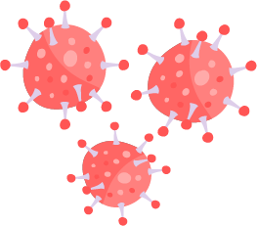
Allergic rhinitis, CRSwNP and asthma are complex and heterogeneous inflammatory conditions of multiple aetiology^{1,2}
Dysfunctional interplay between different host susceptibilities and environmental factors
may instigate and perpetuate the underlying inflammatory response^{1,2}
Environmental factors^{1,2}
Host factors^{1,2}
Allergens
Epithelial barrier
dysfunction
Toxins and pollutants
Abnormal
inflammatory
responses
Microbial agents
Eosinophil
Neutrophil
CRSwNP, chronic rhinosinusitis with nasal polyps
1. Orlandi RR, et al. Int Forum Allergy Rhinol 2016;6(Suppl 1):S22–S209; 2. Laulajainen-Hongisto A, et al. Front Cell Dev Biol 2020;8:204
Notes:
Orlandi RR, Kingdom T, Hwang P, et al. International consensus statement on allergy and rhinology: rhinosinusitis. Int Forum Allergy Rhinol 2016 Feb;6(Suppl 1):S22–S209
Laulajainen-Hongisto A, Toppila-Salmi S, Luukkainen A, et al. Airway epithelial dynamics in allergy and related chronic inflammatory airway diseases. Front Cell Dev Biol 2020 Mar 27;8:204

Slide 8
Pathobiological considerations^{1–5}
Airflow limitation¹
Nasal patency^{2–5}
Bronchial hyperreactivity¹
Inflammation¹
Nasal hyperreactivity^{2–5}
Inflammation^{2–5}
1. Nair P, et al. Clin Chest Med 2012;33:445-457; 2. Feijen J, et al. World Allergy Organ J 2020;13:100132; 3. Velasco E, et al. Allergy 2022;77:1450–1463; 4. Canonica GW, Compalati E. Clin Exp Immunol 2009;158:260–271;
5. Naclerio RM, et al. Int J Gen Med 2010;3:47–57
Notes:
Nair P, Dasgupta A, Brightling C, et al. How to diagnose and phenotype asthma. Clin Chest Med. 2012 Sep;33(3):445-457
Feijen J, Seys S, Steelant B, et al. Prevalence and triggers of self-reported nasal hyperreactivity in adults with asthma. World Allergy Organ J 2020 Jun;13(6):100132
Velasco E, Delicado-Miralles M, Hellings P, et al. Epithelial and sensory mechanisms of nasal hyperreactivity. Allergy 2022 May;77(5):1450–1463
Canonica GW, Compalati E. Minimal persistent inflammation in allergic rhinitis: implications for current treatment strategies. Clin Exp Immunol 2009 Dec;158(3):260–271
Naclerio RM, Bachert C, Baraniuk J. Pathophysiology of nasal congestion. Int J Gen Med 2010 Apr 8;3:47–57

Slide 9
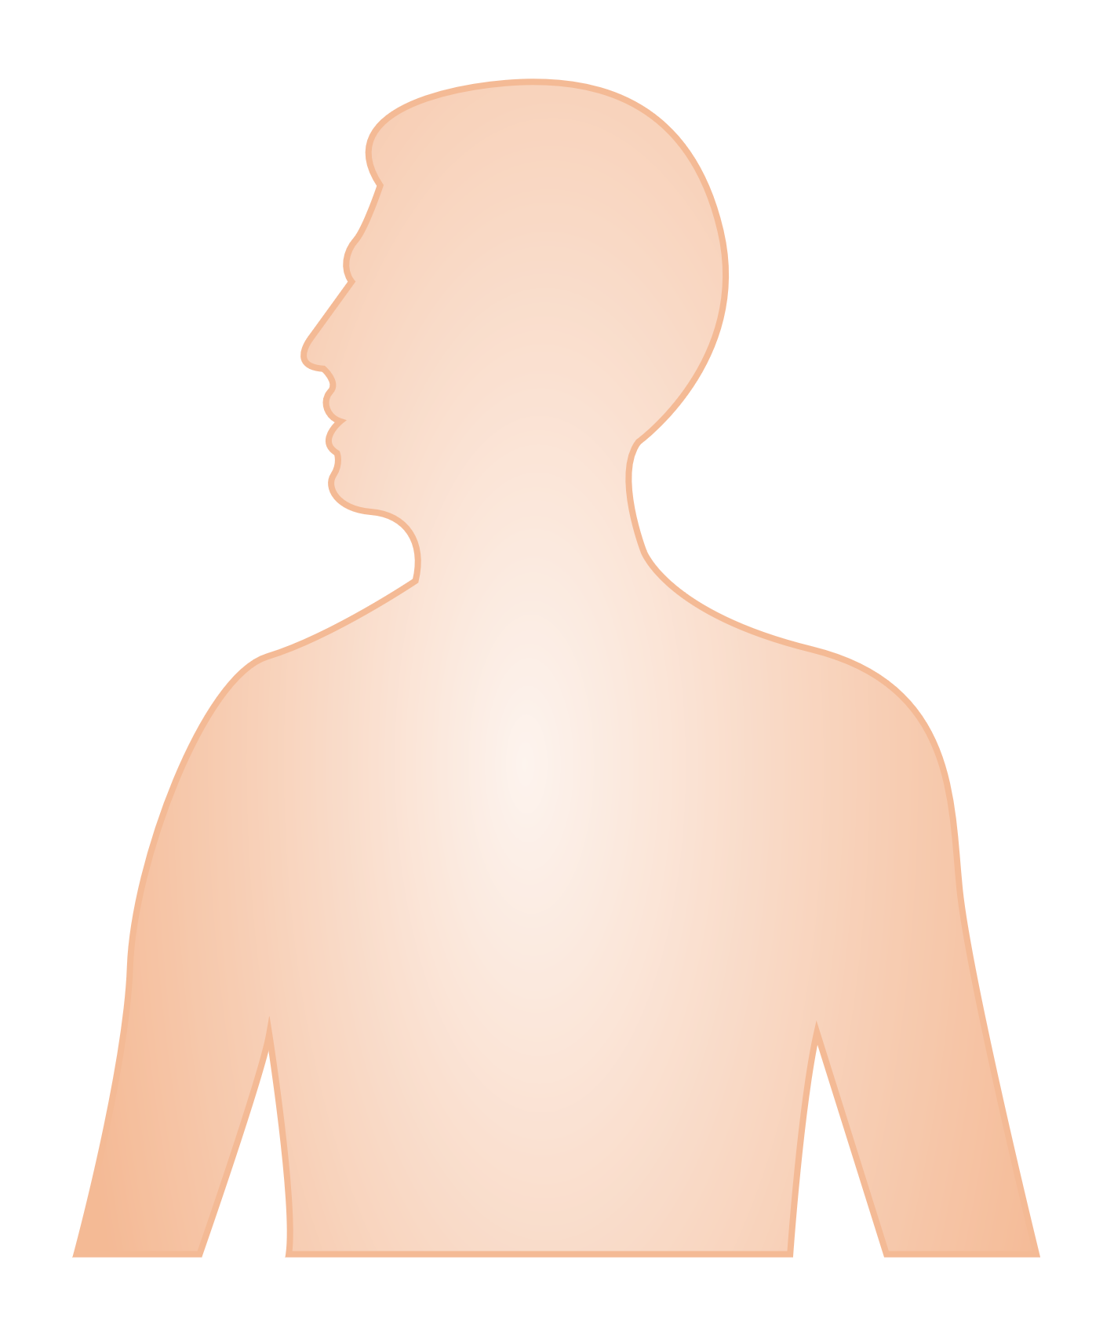


Epithelial structure and functions^{1–11}
Stratified squamous epithelium
Nasal cavity
Forms a physical barrier
Airway smooth muscle cell
Basal
cell
Basement membrane
Pseudostratified columnar ciliated epithelium
Ciliated
cell
Club
cell
Goblet
cell
Upper airways
Facilitates mucus clearance
Releases effector molecules
Differentiates into ciliated cell and goblet cell lineages
Secretes mucus
Squamous
cell
Tuft
cell
Pseudostratified columnar ciliated epithelium
Type 1 alveolar epithelial cell
Type 2 alveolar epithelial cell
Facilitates mucus clearance
Drives bronchoconstriction
Lower airways
Facilitates homeostasis
Releases effector molecules
Beyond structural aspects,
the upper and lower airways share many physiological and immunological features¹¹
Differentiates into ciliated cell lineages
Cuboidal / simple squamous epithelium
Bronchioles and alveoli
Participates in surfactant production
Facilitates gas exchange
Figure adapted from Laulajainen-Hongisto A, et al. Front Cell Dev Biol 2020;8:204, Baldassi D, et al. Adv Nanobiomed Res 2021 May;1:2000111 and Adivitiya, et al. Biology (Basel) 2021;10:95
1. Laulajainen-Hongisto A, et al. Front Cell Dev Biol 2020;8:204; 2. Licari A, et al. Front Pediatr 2017;5:44; 3. Fokkens W, Reitsma S. Otolaryngol Clin North Am 2023;56:1–10; 4. Adivitiya, et al Biology (Basel) 2021;10:95; 5. Baldassi D, et al. Adv Nanobiomed Res 2021;1:2000111; 6. Zhang R, et al. Int Arch Allergy Immunol 2023;184:1–21; 7. Davis JD, Wypych TP. Mucosal Immunol 2021;14:978–990; 8. Jakwerth CA, et al. Cells 2022;11:1387; 9. Doeing DC, Solway J. J Appl Physiol (1985) 2013;114:834–843; 10. Hewitt RJ, Lloyd CM. Nat Rev Immunol 2021;21:347–362; 11. Cho H-J, et al. Rhinology 2021;59:441–450
Notes:
Figure adapted from Laulajainen-Hongisto A, Toppila-Salmi S, Luukkainen A, et al. Airway epithelial dynamics in allergy and related chronic inflammatory airway diseases. Front Cell Dev Biol 2020 Mar 27;8:204, Baldassi D, Gabold B, Merkel O. Air−liquid interface cultures of the healthy and diseased human respiratory tract: promises, challenges, and future directions. Adv Nanobiomed Res 2021 May 6;1(6):2000111 and Adivitiya, Kaushik MS, Chakraborty S, et al. Mucociliary respiratory epithelium integrity in molecular defense and susceptibility to pulmonary viral infections. Biology (Basel) 2021 Jan 29;10(2):95
Laulajainen-Hongisto A, Toppila-Salmi S, Luukkainen A, et al. Airway epithelial dynamics in allergy and related chronic inflammatory airway diseases. Front Cell Dev Biol 2020 Mar 27;8:204
Licari A, Castagnoli R, Denicolò C, et al. The nose and the lung: united airway disease? Front Pediatr 2017 Mar 3;5:44
Fokkens W, Reitsma S. Unified airway disease: A contemporary review and introduction. Otolaryngol Clin North Am 2023 Feb;56(1):1–10
Adivitiya, Kkaushik M, Chakraborty S, Veleri S, et al Mucociliary respiratory epithelium integrity in molecular defense and susceptibility to pulmonary viral infections. Biology (Basel) 2021 Jan 29;10(2):95
Baldassi D, Gabold B, Merkel O. Air−liquid interface cultures of the healthy and diseased human respiratory tract: promises, challenges, and future directions. Adv Nanobiomed Res 2021 May 6;1(6):2000111
Zhang R, Zhang L, Li P, et al. Epithelial barrier in the nasal mucosa, related risk factors and diseases. Int Arch Allergy Immunol 2023 Feb 1;184(5):1–21
Davis JD, Wypych TP. Cellular and functional heterogeneity of the airway epithelium. Mucosal Immunol 2021 Sep;14(5):978–990
Jakwerth CA, Ordovas-Montanes J, Blank S, et al. Role of respiratory epithelial cells in allergic diseases. Cells 2022 Apr 20;11(9):1387
Doeing DC, Solway J. Airway smooth muscle in the pathophysiology and treatment of asthma. J Appl Physiol (1985) 2013 Apr;114(7):834–843
Hewitt RJ, Lloyd CM. Regulation of immune responses by the airway epithelial cell landscape. Nat Rev Immunol 2021 Jan 13;21(6):347–362
Cho H-J, Ha J, Lee S, et al. Differences and similarities between the upper and lower airway: focusing on innate immunity. Rhinology 2021 Oct 1;59(5):441–450

Slide 10
Role of TSLP, IL-25 and IL-33 in allergic rhinitis^{1–4}
In patients with allergic rhinitis, TSLP, IL-33 and IL-25 are released following allergen exposure, leading to T2 inflammation through the cytokines IL-4, IL-5 and IL-13^{1–3}
These epithelial cytokines play a role in the initiation and maintenance of T2 inflammation through production of IL-4, IL-5 and IL-13,^{1–4}
all of which can lead to chronic allergic symptoms and inflammation in allergic rhinitis, as well as remodelling and nasal hyperresponsiveness^{1,2}
Early phase^{1,2}
Late phase^{1,3,4}
Allergen binding
to IgE and inflammatory cells
Allergen exposure
Release of TSLP,
IL-33 and IL-25
Mast cell degranulation
Allergic symptoms
IgE, immunoglobulin E; IL, interleukin; T2, Type 2; TSLP, thymic stromal lymphopoeitin
1. Yii AC, et al. Allergy 2018;73:1964–1978; 2. Sin B, Togias A. Proc Am Thorac Soc 2011;8:106–114; 3. Wise SK, et al. Int Forum Allergy Rhinol 2018;8:108–352; 4. Bousquet J, et al. Nat Rev Dis Primers 2020;6:95
Notes:
Yii AC, Tay T-R, Choo X, et al. Precision medicine in united airways disease: A "treatable traits" approach. Allergy 2018 Oct;73(10):1964–1978
Sin B, Togias A. Pathophysiology of allergic and nonallergic rhinitis. Proc Am Thorac Soc 2011 Mar;8(1):106–114
Wise SK, Lin SY, Toskala E, et al. International Consensus Statement on Allergy and Rhinology: Allergic Rhinitis. Int Forum Allergy Rhinol 2018 Feb;8(2):108–352
Bousquet J, Anto J, Bachert C, et al. Allergic rhinitis. Nat Rev Dis Primers 2020 Dec 3;6(1):95

Slide 11
Expression of TSLP, IL-25 and IL-33 are elevated in CRSwNP^{1–3}
TSLP levels are higher in nasal polyp
tissues compared with uncinate
process tissues from control subjects¹*
IL-25 levels are elevated in nasal epithelial cells of patients with
CRSwNP, compared with
control subjects^{2‡}
Levels of IL-33 are increased in
uncinate process tissues from patients with CRSwNP compared with
control subjects^{3$}
10
2.5
P<0.01
2
P<0.01
2
P<0.001
7.5
P<0.05
P<0.01
1.5
TSLP mRNA expression
(ratio to control)†
1
5
IL-25 mRNA expression
IL-33/total protein (ng/mg)
1
2.5
0.5
0
0
Control
-UP
CRSsNP
-UP
CRSwNP
-UP
NP
0
Control
CRSwNP
UP
NP
n=4
n=10
n=17
n=9
n=7
n=27
n=36
n=4
Figures adapted from Kobayashi Y, et al. Biomolecules 2020;10:326, Liu R, et al. Front Immunol 2021;12:530488 and Kim D-K, et al. Thorax 2017;72:635–645
*Tissue specimens were obtained from nasal polyps in the ethmoid sinuses of patients with eosinophilic CRSwNP and UP tissues of patients with allergic rhinitis or eosinophilic CRSwNP¹; †Values represent the ratio to control (UP tissue from patients with allergic rhinitis)¹; ‡Nasal epithelial cells were obtained from brushings of the turbinate of control subjects and nasal polyps of patients with CRSwNP, respectively²; $UP tissue specimens were obtained from control subjects without any sinonasal diseases and patients with CRSsNP or CRSwNP, and nasal polyp tissues obtained from patients with CRS³
CRS, chronic rhinosinusitis; CRSsNP, chronic rhinosinusitis without nasal polyps; CRSwNP, chronic rhinosinusitis with nasal polyps; IL, interleukin; mRNA, messenger RNA; NP, nasal polyp; TSLP, thymic stromal lymphopoietin;
UP, uncinate process
1. Kobayashi Y, et al. Biomolecules 2020;10:326; 2. Liu R, et al. Front Immunol 2021;12:530488; 3. Kim D-K, et al. Thorax 2017;72:635–645
Notes:
Kobayashi Y, Kanda A, Yun Y, et al. Reduced local response to corticosteroids in eosinophilic chronic rhinosinusitis with asthma. Biomolecules 2020 Feb;10(2):326
Liu R, Du J, Zhou J, et al. Elevated microRNA-21 is a brake of inflammation involved in the development of nasal polyps. Front Immunol 2021 Apr 15;12:530488
Kim D-K, Jin HR, Eun KM, et al. The role of interleukin-33 in chronic rhinosinusitis. Thorax 2017 Jul;72(7):635–645

Slide 12
Expression of TSLP and IL-33 are elevated in asthma¹
BALF TSLP expression increased with asthma severity¹*
BALF IL-33 concentration increased with asthma severity¹*
1000
100
P=0.0393
TSLP (pg/mL)
P=0.0428
P=0.0202
Log IL-33 (pg/mL)
P=0.0342
P=0.0378
P=0.043
100
10
10
1
1
0.1
0.1
Healthy controls
Mild asthma²
(no ICS or OCS)
Mild-to-severe asthma requiring ICS²
(no OCS)
ICS + OCS dependent
asthma
Healthy controls
Mild asthma²
(no ICS or OCS)
Mild-to-severe asthma requiring ICS²
(no OCS)
ICS + OCS dependent
asthma
n=30
n=29
n=21
n=20
n=30
n=29
n=21
n=20
Figures adapted from Li Y, et al. J Immunol 2018;200:2253–2262
*Normal control patients were healthy, lifelong non-smoking volunteers who had no history of lung disease¹
BALF, bronchoalveolar lavage fluid; ICS, inhaled corticosteroid(s); IL, interleukin; OCS, oral corticosteroid(s); TSLP, thymic stromal lymphopoietin
1. Li Y, et al. J Immunol 2018;200:2253–2262; 2. Global Initiative for Asthma (GINA). Global Strategy for Asthma Management and Prevention. 2023. Available from: https://ginasthma.org/wp-content/uploads/2023/07/GINA-2023-Full-report-23_07_06-WMS.pdf (Accessed 6 October 2023)
Notes:
Figures adapted from Li Y, Wang W, Lv Z, et al. Elevated expression of IL-33 and TSLP in the airways of human asthmatics in vivo: A potential biomarker of severe refractory disease. J Immunol 2018 Apr 1;200(7):2253–2262
Li Y, Wang W, Lv Z, et al. Elevated expression of IL-33 and TSLP in the airways of human asthmatics in vivo: A potential biomarker of severe refractory disease. J Immunol 2018 Apr 1;200(7):2253–2262

Slide 13
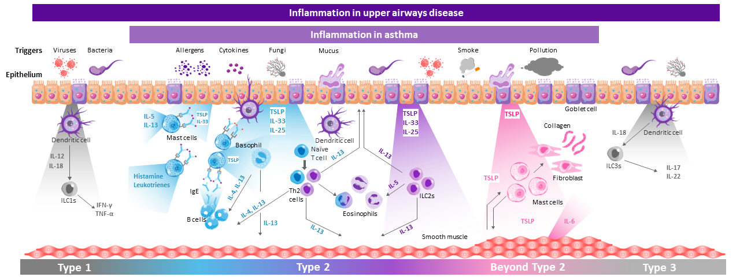
Similar inflammatory processes are associated with both upper and lower airways diseases^{1–6}
Figure adapted from Porsbjerg CM, et al. Eur Respir J 2020;56:2000260, Gauvreau GM, et al. Expert Opin Ther Targets 2020;24:777–792 and Fokkens WJ, et al. Rhinology 2020;58(Suppl S29):1–464
Mechanisms underlying non-eosinophilic inflammation in asthma and the relevance of TSLP in its potential effects on macrophages both require further elucidation. The information presented in this image has been simplified for illustration purposes only and does not imply clinical benefit or relevance
IFN, interferon; IgE, immunoglobulin E; IL, interleukin; ILC, innate lymphoid cell; Th, T helper; TNF, tumour necrosis factor; TSLP, thymic stromal lymphopoietin
1. Yii AC, et al. Allergy 2018;73:1964–1978; 2. Laulajainen-Hongisto A, et al. Front Cell Dev Biol 2020;8:204; 3. Fokkens W, Reitsma S. Otolaryngol Clin North Am 2023;56:1–10; 4. Parnes JR, et al. J Asthma Allergy 2022;
15:749–765; 5. Fokkens WJ, et al. Rhinology 2020;58(Suppl S29):1–464; 6. Victor AR, et al. J Immunol 2017;199:2333–2342
Notes:
Figure adapted from Porsbjerg CM, Sverrild A, Lloyd C, et al. Anti-alarmins in asthma: targeting the airway epithelium with next-generation biologics. Eur Respir J 2020 Nov 12;56(5):2000260, Gauvreau GM, Sehmi R, Ambrose C, et al. Thymic stromal lymphopoietin: its role and potential as a therapeutic target in asthma. Expert Opin Ther Targets 2020 Aug;24(8):777–792 and Fokkens WJ, Lund VJ, Hopkins C, et al. European Position Paper on Rhinosinusitis and Nasal Polyps 2020. Rhinology 2020 Feb 20;58(Suppl S29):1–464
Yii AC, Tay T-R, Choo X, et al. Precision medicine in united airways disease: A "treatable traits" approach. Allergy 2018 Oct;73(10):1964–1978
Laulajainen-Hongisto A, Toppila-Salmi S, Luukainen A, et al. Airway epithelial dynamics in allergy and related chronic inflammatory airway diseases. Front Cell Dev Biol 2020 Mar 27;8:204
Fokkens W, Reitsma S. Unified airway disease: A contemporary review and introduction. Otolaryngol Clin North Am 2023 Feb;56(1):1–10
Parnes JR, Molfino NA, Colice G, et al. Targeting TSLP in asthma. J Asthma Allergy 2022 Jun 3;15:749–765
Fokkens WJ, Lund VJ, Hopkins C, et al. European Position Paper on Rhinosinusitis and Nasal Polyps 2020. Rhinology 2020 Feb 20;58(Suppl S29):1–464
Victor AR, Nalin AP, Dong W, et al. IL-18 drives ILC3 proliferation and promotes IL-22 production via NF-κB. J Immunol 2017 Oct 1;199(7):2333–2342

Slide 14
Conclusions
Nasal and bronchial epithelia present core similarities and differences in terms of structure
and function^{1,2}
Epithelial impairment potentially impacts on both upper and lower airways, regardless of
its localisation at onset^{1,3}
The united airways concept, highlighted by epidemiological and pathobiological evidence,
is further sustained by the epithelial barrier dysfunction perspective¹
A personalised approach is recommended for patients in terms of both diagnostic work up and treatment identification¹
1. Fokkens W, Reitsma S. Otolaryngol Clin North Am 2023;56:1–10; 2. Cho H-J, et al. Rhinology 2021;59:441–450; 3. Laulajainen-Hongisto A, et al. Front Cell Dev Biol 2020;8:204
Notes:
Fokkens W, Reitsma S. Unified airway disease: A contemporary review and introduction. Otolaryngol Clin North Am 2023 Feb;56(1):1–10
Cho H-J, Ha J, Lee S, et al. Differences and similarities between the upper and lower airway: focusing on innate immunity. Rhinology 2021 Oct 1;59(5):441–450
Laulajainen-Hongisto A, Toppila-Salmi S, Luukkainen A, et al. Airway epithelial dynamics in allergy and related chronic inflammatory airway diseases. Front Cell Dev Biol 2020 Mar 27;8:204

